Slide 1

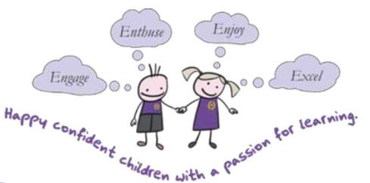
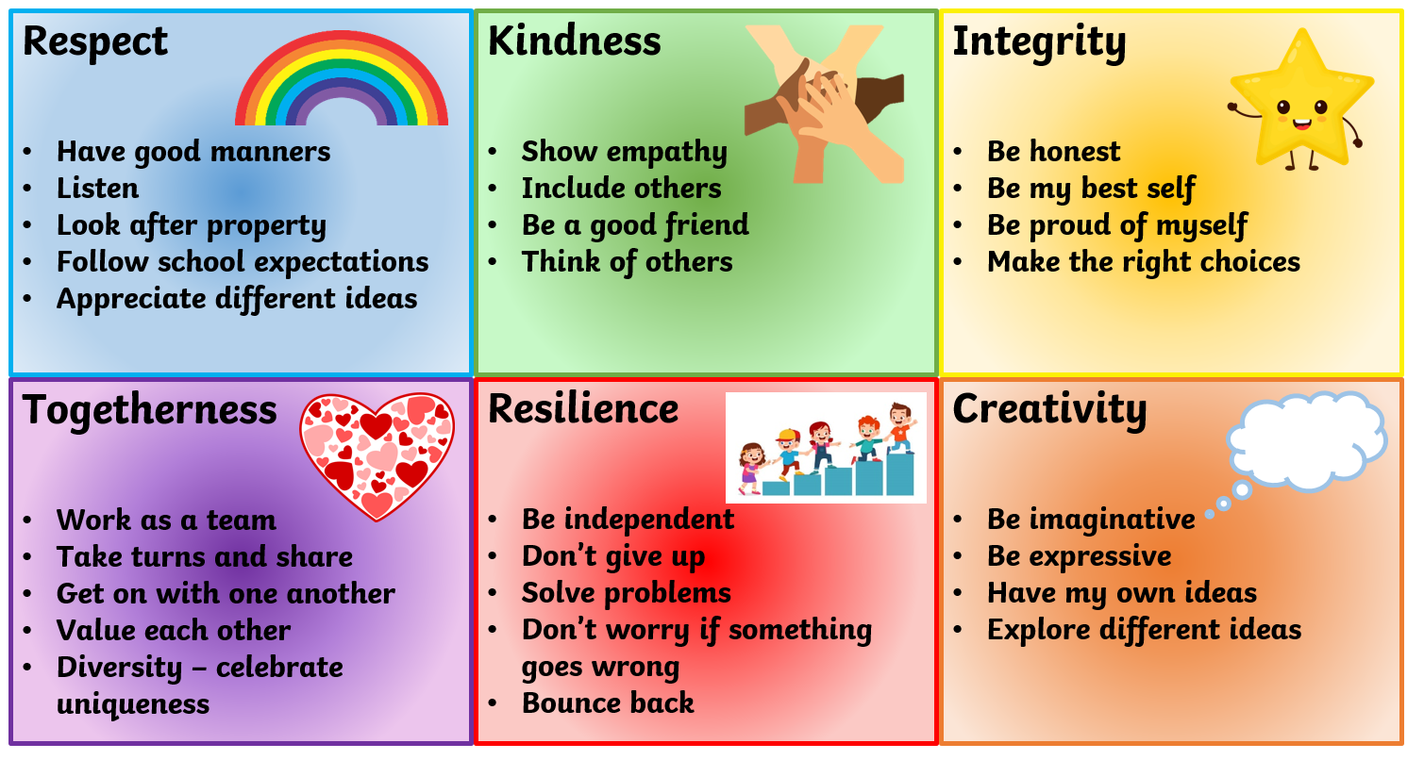
Year 2 Curriculum Presentation
Autumn Term
2025

Slide 2
During this presentation we will...
Give information regarding organisation and routines
Clarify expectations, standards & progression in Year 2
Explain how we organise teaching & learning in;
  Reading
  Writing
  Maths
  Foundation subjects

Slide 3
The National Curriculum
Core Subjects:
English
Maths
Science
Foundation Subjects:
Art & Design, Computing, Design & Technology, Geography, History, Music, PE, RE
Wider Learning:
School Values
How we learn best
Enrichment and experiences
Personal, Social & Health Education
Notes:
ALL areas with star are needed for GLD…

Slide 4
The School Day
Registration & lunch order
Reading
Assembly / Story
Break
Maths
Foundation Subject
Morning Task
English
Foundation Subject
Lunch
Phonics
Handwriting
Notes:
This may change depending on timetable

Slide 5
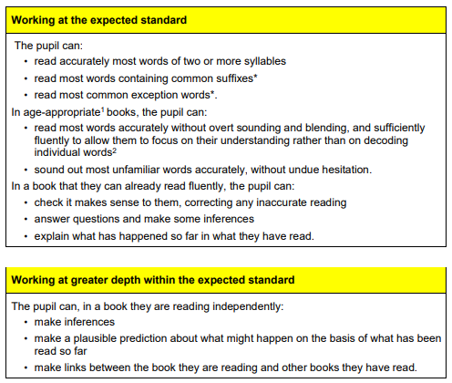
Assessment in Year 2
- Ongoing
- Phonics (retakes in June if did not pass Phonics screening in Y1)
- End of Key Stage assessments – (End of year report to parents and information passed to Junior School.)
Notes:
TAFs – this isn’t a best fit. The children must achieve each statement in order to secure that judgement.

Slide 6
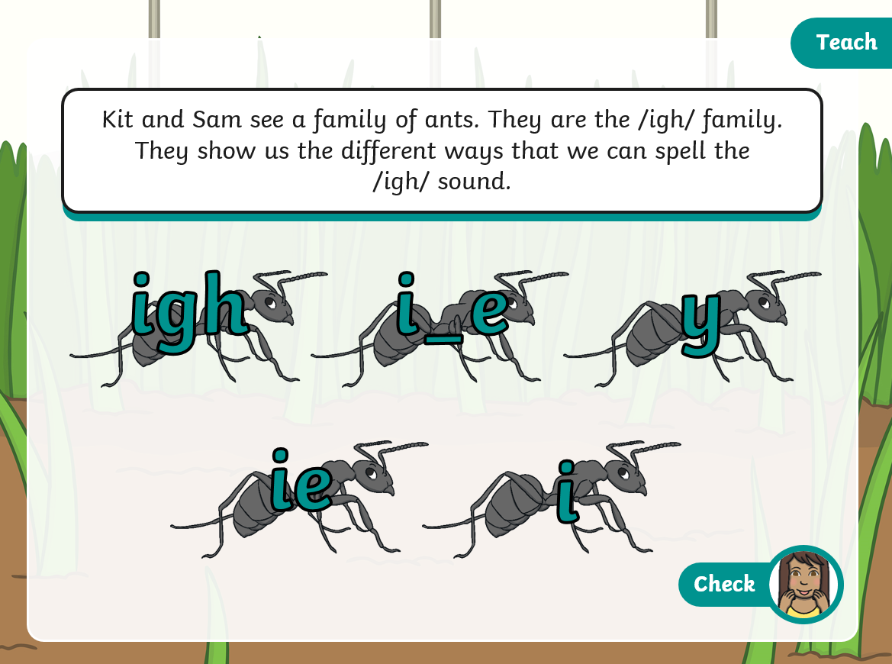


Reading and phonics
Twinkl Phonics Scheme – aim to complete Level 6
Phonically decodable books matched to current level
Move on to Book Band books
Guided reading
Library books
Notes:
Level 6 phonics includes the remaining sounds to be taught, as well as introducing children to spelling rules.
Reading at home – little and often. Especially as the books get longer, please don’t feel that you have to finish them. Keep it short and focused.

Slide 7

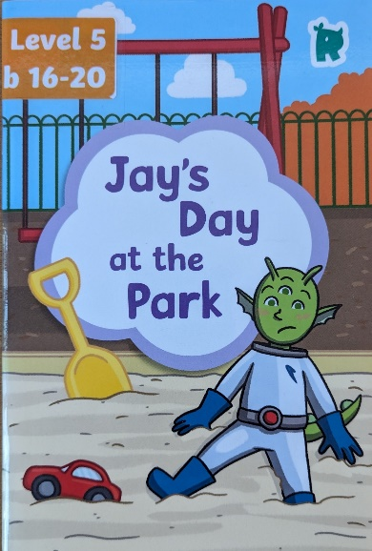
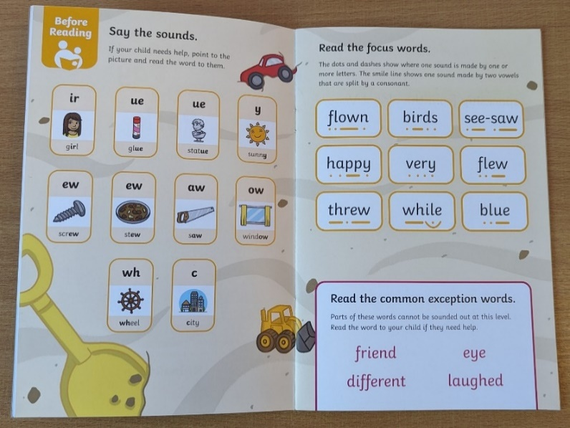
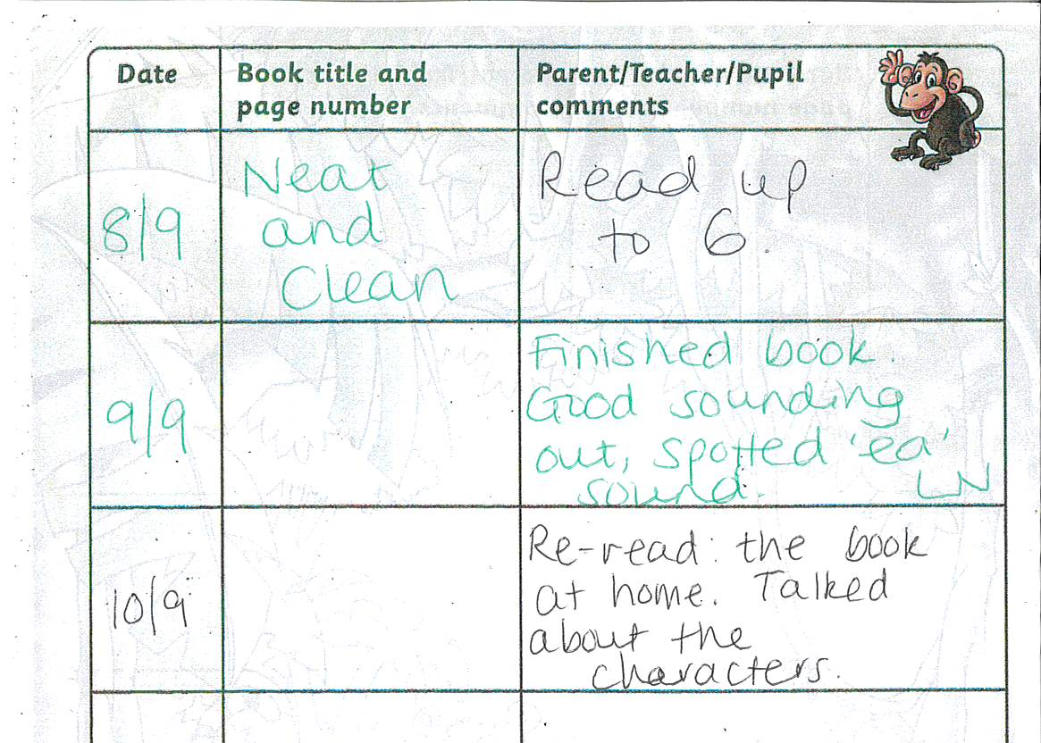
Reading at home
Adults in school often write in the book title and the date
Please write a comment OR just initial OR even a smiley face to help us know your child has read at home.
Aim for reading the book twice before changing – 1st read focus on sounding out and blending, decoding. 2nd read focus on developing fluency, pace and talking more about the book.
Notes:
Level 6 phonics includes the remaining sounds to be taught, as well as introducing children to spelling rules.
Reading at home – little and often. Especially as the books get longer, please don’t feel that you have to finish them. Keep it short and focused.

Slide 8





Reading
Sharing books and reading – please support this at home as much as possible!
The vocabulary children have heard by age 5 varies greatly
and this is influenced by the number of books they hear each week.
6-7 times
3-4 times
1-2 times
0 times
4,662 words
63,570 words
169,520 words
296,660 words
Notes:
Vocabulary heard at 5 years old

Slide 9
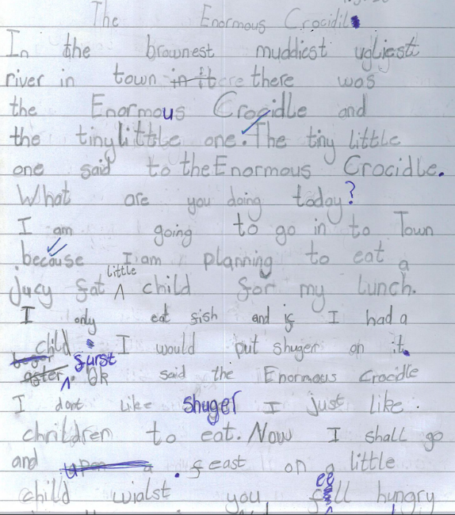
Writing
Various hooks and stimuli for writing, including high quality texts
Opportunities to practise key skills before applying to more independent writing
Key aspects to focus on
  Re-read - Does it make sense? (Sentence level & Text level)
  Phonetically plausible spellings for
  unknown words (e.g. resighcle for recycle)
  Starting to apply spelling rules
  Punctuation
  Remembering/correcting common exception words
  For greater depth:
  Vocabulary and punctuation (drawing from their reading)
  chosen to match the purpose and have an impact on the reader
Notes:
Level 6 phonics includes the remaining sounds to be taught, as well as introducing children to spelling rules.
Reading at home – little and often. Especially as the books get longer, please don’t feel that you have to finish them. Keep it short and focused.

Slide 10
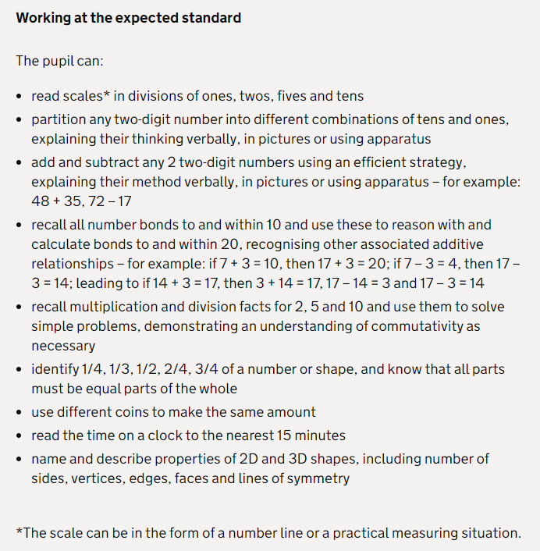
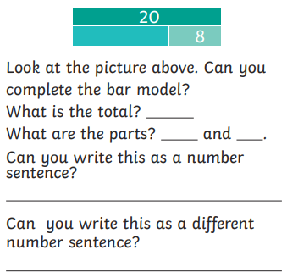
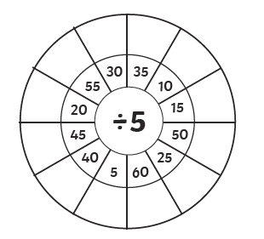

Maths

Slide 11
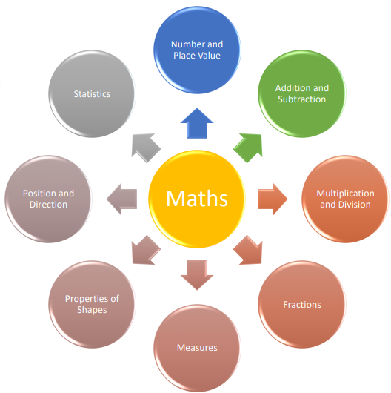




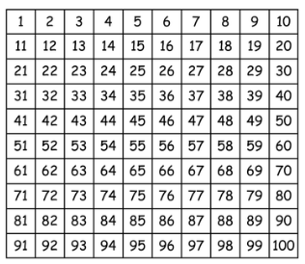

Children need to be secure in:
understanding numbers to 100
number bonds to 20,
x2, x5, x10 tables and associated division facts
See maths booklet on our website for lots more ideas
Notes:
Mental maths and problem solving
Discussions and explanations – verbalise ‘How’
Jottings or pictures to help understanding
Resources for counting and calculating eg fingers, number line, 100 square, Numicon, blocks and counters - Select their own resources to aid task
Children need to show their working out
Lots of practical activities – inside and outside
Challenges/investigations – open ended questions and real life problems
WRM – watch videos at home too

Slide 12
How you can help at home
Modelling correct speech and vocabulary. Having conversations.
Read with (and to) your child as much as possible – use the reading record to record what you have read.
Practise their weekly spellings
Encourage opportunities to write – shopping lists, letters, made up stories, etc.
Everyday maths e.g. weighing, measuring, fractions ½ ¼ ¾ ⅓, handling money, practise telling and writing the time (o’clock, half past, quarter past and quarter to)
Practical activities at home e.g. cooking, weighing, shopping, measuring length with standard and non-standard measures
White Rose Maths at home
Notes:
Little and often is best, reluctant readers – you read a page they read a page or ‘ghost’ read (read along at the same time).

Slide 13
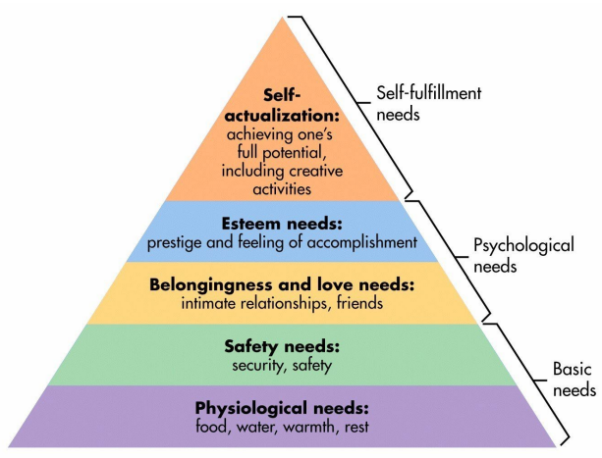
Being ready to learn
family,
Notes:
Basic needs – it is very hard for a child to feel motivated to learn if these are not met, e.g. feeling hungry or feeling tired. ***This is something you can help with at home!!***
Self actualisation and esteem – we aim to praise and encourage children to achieve well in all areas of the curriculum and their development.

Slide 14
Instead of ‘How was your day?’ …
In the moment:
Focus on how pleased you are to see them.
Try to spot and name their emotion for them.
Choose your time carefully…
Before bedtime
After a snack
Whilst colouring etc.
Model it:
Show them what it sounds like to talk about YOUR day. Something that surprised you, made you laugh…
Don’t jump into interview mode… Be curious
Children can find it hard to generalise, “I had no one to play with today” can mean that for 5 minutes their friends were still in the hall eating lunch, and after that they came outside and they played together. Try and help find ways to get children to tell you more about what happened and prompt for what they could do.

Slide 15
How we work together to support your child
Homework There will be no weekly official homework other than the reading and spelling practise. We may ask for items to be brought in e.g.: cardboard tubes, photos etc.
Book bags please can you check your child’s book bag every night to look for things like pictures, invitations or other school communication. 1 key ring only please!
Water we actively encourage the children to regularly drink water and bring in their own named water bottle for the classroom.
Uniform must be labelled with your child’s name.

Slide 16

Finally…
Working in partnership with you is very important to us so please come and talk to us at the end of the school day with any questions or concerns. Alternatively you can email or call the school to arrange a mutually convenient time to talk.
We look forward to seeing you at workshops e.g.: Reading, Maths, open mornings, book looks
Parents’ Evenings are also an opportunity to see how your child is progressing and be given personalised targets for their next steps
School is always looking for volunteers. Please enquire at the office!

