Slide 1
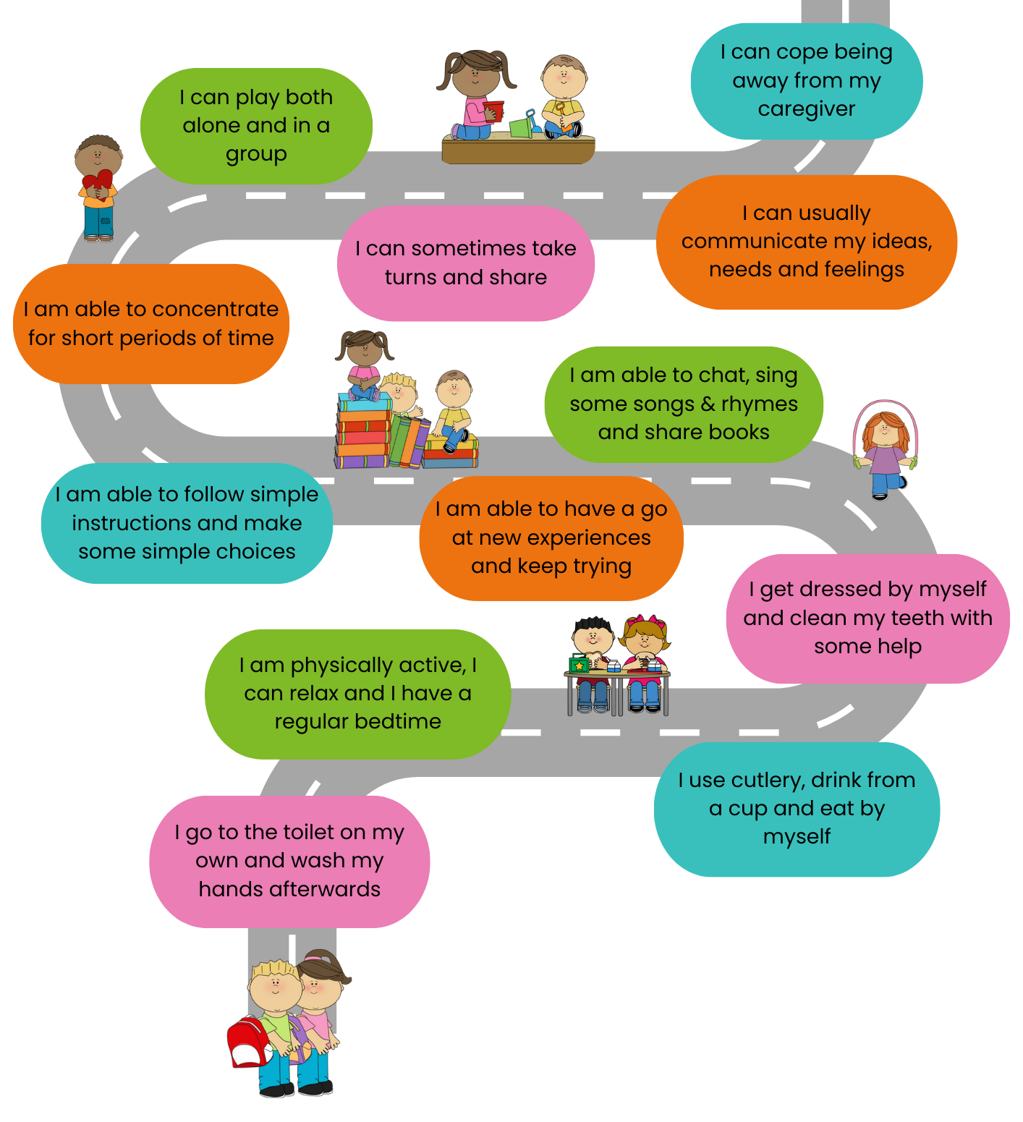
Two and Beyond
Your child’s learning journey
Notes:
Introductions & Housekeeping:
Hampshire Healthy Families is a partnership between Hampshire & IOW NHS Healthcare Foundation Trust & Barnardo’s. There is a Community Health Development Worker in every Hampshire locality with localised small teams of volunteers. We support health visiting teams across Hampshire to inform parents of the latest health and well-being messages for families with babies, young children & teens through:
The Hampshire Healthy Families website: portal to health info for 0-19s
Updates on Facebook & Instagram
Health Roadshows to community groups: Parent & Toddler & EY settings
Ready Steady Walks
Befriending services
Sessions for parents and EY settings including:
Five to Thrive (FTT) for new parents
Two & Beyond
Family Food and Fun
Baby Talk & Toddler Talk
Hampshire Healthy Heroes (EY Settings)
Today’s workshop supports healthy development for children aged two and beyond. We’ll be discussing personal, social & emotional development; communication; growing independence; and healthy routines.
Although it might seem a long way off at the moment, the skills that are outlined here will eventually help your child to be ready for school when the time comes.
We will email you with a link to our padlet of resources and information to support the content of this workshop.
Please feel free to ask questions as we go along and at the end of the session.

Slide 2

You can build your child's brain by:
Giving them your attention
Responding to them
Interacting with them
Notes:
As a parent/carer you are quite literally a brain builder and an emotional coach! The early years (from conception to three years old) have the most impact on a child’s future.
Early life experiences, both positive and negative, affect the way your child’s brain cells connect. This shapes their journey into adulthood. A positive relationship between you and your child supports their healthy brain development. You can help build your child's brain by:
Giving them your attention
Responding to them with empathy
Interacting with them
The brain takes around 25 years to become emotionally mature, and it makes new connections throughout childhood. It might be helpful to see your child's behaviour as 'distressed' rather than 'naughty’. This will help you create a learning opportunity and react in a comforting, kind way. When your child is distressed, try to ‘connect before you correct’ by seeing things from their point of view:
Calmly tell your child that you can see they’re sad/angry/frustrated, and you know how difficult that is. This helps you to connect and helps them learn this feeling and how to react to it.
Explain clearly why they can’t have, or do, what they want.
Finally support your child with problem solving to help them learn and think for themselves. In future, they may cope better and manage things differently.
It’s important to remember we’re not perfect all the time! If you did not respond to your child’s behaviour in the best way, make a repair by explaining in a simple way why it happened. Make sure you also stay connected. This will show your child how to learn from mistakes and move on.
Babies and young children need to form trillions of brain connections to help them to develop the social, emotional and physical skills that will help them throughout their lives. Supporting the development of skills and introducing routines that will impact positively on children’s behaviour also gets them off to the best start when they begin their early years education and eventually go to school. We’ll take a look at some of these key skills and how to encourage and nurture them during the session.

Slide 3

I can cope being away from my caregiver
Notes:
If your child is due to start attending an early years setting or will soon be going to school, it’s perfectly natural for you to be worried. A recent survey by *Pacey showed that 71% of parents feel anxious about their child staring school.
Many parents worry about how their child will cope with separation. The Kindred Squared Report that looked into school readiness (published in Feb 2024) stated that 32% of children were overly upset when separating from a parent or main carer.
Some children may experience tears, fears and tummy aches and may even become angry or defiant. This is probably because they are worried about leaving you or missing you. Remember to validate those feelings by saying that you will miss them too and it’s normal to feel this way, but they are likely to have fun, learn new things and make new friends.
Before your child is at this stage, practise spending time away from them, leaving them with a familiar trusted adult, perhaps for short periods to start with, and build it up gradually. It will give your child coping skills for when they eventually have to separate from you and it’s helpful for you to know that they can cope too.
When the time comes, make your goodbye rituals short and sweet – assure your child that you will return to collect them and always make sure that you arrive on time. If they cry, remember to listen, observe, validate and empathise (LOVE acronym). Tell them that they’re safe and that there is an adult that they can speak to if they need a bit of help. If you are feeling emotional, try not to let them see you cry –if you do, assure them that it’s not because you’re sad or worried.
Maybe think about sewing a little kiss into the cuff of their sweatshirt so that they feel a connection to you when you are apart.
You will already have started the journey to ‘school readiness’ if your child is in an early years setting. They will be used to spending time away from you. It also means that you have had a partnership with an education provider.
If your child does not attend an early years setting and access free funded hours, take a look at the HCC Childcare Choices information included in our post-session padlet. It can really help their overall development and increase social interaction opportunities.
* PACEY is the Professional Association for Childcare and Early Years.

Slide 4
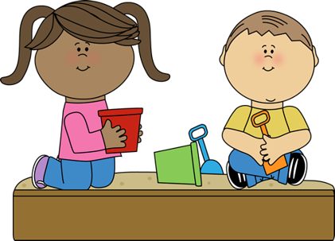
I can play both alone, and in a group
“Playing with me and helping me to play alone and with other children builds connections in my brain that make it possible for me to think & plan, to make sense of the world around me and to develop social skills”
Notes:
Play helps children to make sense of the world and helps them to develop their imagination. It is an essential part of healthy development.
The best way to engage with your child is to notice and make use of their unique interests. We all learn best when we find something interesting or when it is something that we have chosen ourselves.
Neuroscience shows us that children’s brains light up much more strongly when they choose and then take the lead in their play. It gives them the space to build on what they know and use their imagination. You can then join in and support the play.
Children will sometimes want to play on their own and will find things to do independently –at other times they need adults to give them ideas for a starting point.
Solitary play helps children to explore their inner world, their own ideas and creativity. Wallowing in this kind of play can be relaxing and really supports your child’s self-confidence and independence. These are personal skills that will be beneficial for life at school.
Exposure to screens such as TVs and electronic devices can interfere with this kind of play as children start seeking constant visual stimulation, and the dopamine hit, so this needs to be carefully managed.
The World Health Organisation recommends no more than one hour of screen time per day for two to five-year-olds but, less is better (that includes TV as well as other electronic devices) and no screen time for the under twos.
The Kindred Squared Report states that 38% of children struggle to play with other children. Arranging play dates in a variety of different environments, such as your home, other people’s homes, toddler groups, libraries or soft play will give your child chance to practise and learn important social skills such as sharing, taking turns, negotiating and managing conflict & emotions.
These are complex skills for two-year-olds, but the more exposure they have to social situations, the more they will be learning about how to behave appropriately in social situations.

Slide 5
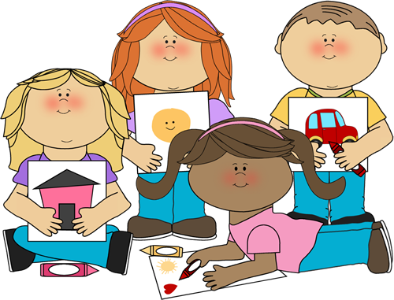
I can sometimes take turns and share
Notes:
Young children should sometimes be able to take turns and share. These skills develop at different rates so don’t be tempted to compare your child with others of a similar age, but this is an important milestone as they reach school age.
You can support your child with some simple games such as ‘go games’ that involve rolling a ball to each other (this also helps with listening skills, attention and following instructions).
You might take turns in stacking blocks in a tower, using the words ‘my turn, your turn’ to help your child to understand the concept of waiting for their turn.
Simple games like Snakes & Ladders, Hungry Hippos, Connect 4, and Snap will all provide good opportunities for taking turns.
Sharing can be very complex and difficult for toddlers, especially if it involves something special! Your choice of language may make a difference here. For children under three, it might be more helpful to encourage them to ‘take turns’ rather than try to insist that they ‘share’. Teaching young children not to snatch may be more appropriate than expecting the other child to share. This helps with impulse control and boundaries.
Demonstrate and talk about how you share something with your child, maybe a banana or an apple and then explain why you did that (because you care; it makes you feel good etc). Also talk about sharing feelings and thoughts.
As children get older, they start to recognise the caring side of sharing and it’s important to notice when they do this, because they enjoy positive reactions from others which may also lead them to do it more.
With patience, children will learn to feel how good it feels when someone else shares with them and will start to realise how it connects them with others.

Slide 6
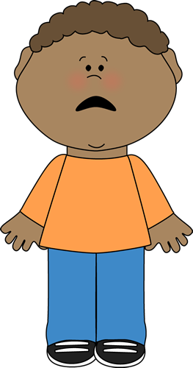

I can usually communicate my ideas, needs and feelings
Notes:
Having an immature brain and developing communication skills to convey ideas, needs & feelings can sometimes make the world a frustrating place for young children, especially when big emotions surge. What we may deem as nothing, could provoke a big emotional response from a child, e.g. we hand them the blue cup and they want the pink one!
The amygdala, a central part of the brain, responsible for processing feelings and emotions, is still learning from real life experiences. It is learning that not all things are dangerous to us, and therefore don’t need a fight, flight or freeze response – but this takes time, repetition of experiences, and a calm nurturing adult to respond in a way that helps to settle down early instincts and help form new connections in the brain.
Neuroscience tells us that we emotionally mature over a long period of time, remember 25 years on average! (some evidence shows that this can differ between males & females too). So, its developmentally typical and appropriate that young children will sometimes show us their feelings through behaviour, not always calmly or with words.
By co-regulating with supportive, empathetic adults, children start to gain control over their own behaviour & emotions. This is called self-regulation. Co-regulation with reliable, patient & compassionate adults comes before self-regulation.
Here are some ways in which you can co-regulate when your child is distressed :
Have realistic expectations – behaviour is also a way of expressing a need
Remain calm yourself, especially when children struggle to express their needs or emotions
Respond in a way that communicates that your child is safe and that they matter – Listen, Observe, Validate & Empathise (be available for cuddles and reassurance)
Model vocabulary that supports emotional literacy, e.g. I can see you might be angry because we can’t go outside right now……offer some guided choices
Model and do simple breathing exercises together e.g. trace round fingers breathing slowly in & out (take five hand breathing), blow out pretend birthday candles (fingers)
Create something that uses colours as visuals for feelings, e.g. coloured sensory bottles; green for calm, red for angry, yellow for happy, blue for sad etc
Make a sensory box for calming emotions – collect things around the house that engage the senses and help with grounding, e.g. something to smell (lavender bag), something to feel (feather or shell), cuddle a soft teddy, use a ‘pop it’, scrunch some paper or pull a stretchy band

Slide 7

“It’s important for me to know how to communicate and develop skills so that I feel comfortable to make good relationships ”
Notes:
As children get older, their relationships with their peers become increasingly important to them.
In a study* in 2018, children who had already been in reception class for 7 months were asked what they thought a new school starter would need to know. They highlighted the need to be able to make friends, say “hi” in the playground and be included. Children are much more focused on these emotional issues, whilst adults are often more focussed on achievement.
Children may communicate in different ways. They may speak different languages and use different words to say, “hi” and some children may use sign language.
Children can struggle with feelings of rejection if they don’t know how to join in or if they lack the confidence to start a conversation. Feeling a sense of belonging is a strong emotional need.
This is why your child’s relationship with adults in early years settings and schools is also important, because their connection with their key person should help them to feel safe and ready to learn.
Communication and language development expands rapidly between the age of one-and-a-half and three years. Human interaction is crucial for communication, speech and language development. Serve & return interactions, where you both take turns, like in a game of tennis, will help to form the strongest connections in your child’s brain. No app can replace your lap!
Research is showing us that excessive screen time is impacting on children’s speech & communication skills, the ability to read emotions and the development of empathy. In some cases, children are even becoming reluctant to engage socially.
Screen time can also lead to irritability and impact on your child’s co-operation with others. If your child does watch TV or use a screen, it’s essential to monitor content to ensure that it’s appropriate and to talk about it with them, so that you enhance the learning.
*Christine O’Farrelley et al

Slide 8

I am able to chat, sing some songs & rhymes and share books
Notes:
You do not need to teach your child to read, write & do sums before they start school. Just Relax, Play, Talk and have fun,
In 2018, The National Literacy Trust developed the Chat, Play, Read strategy to support parents to understand the importance of chatting, playing and reading with their children. You can remember it as CPR because communication is crucial for life and a skill that will help your child to be ready for school and making friends.
Young children might not sit through a whole story book but with reports of 28% of children ‘swiping’ the pages of a book as if using a screen when they start school, it’s important that they learn how to handle books, understand that text goes from left to right and that words and pictures convey meaning. Talking about the pictures is also a good way to develop vocabulary and speech.
Singing also helps to build vocabulary and fluency in speech, as well as developing a sense of rhythm and rhyme. In fact, singing lights up more parts of the brain than when we just speak and listen! It also helps children to release happy hormones and feel a sense of connection to others. Many nursery rhymes include repetition which is important for the development of speech. It’s useful to listen to a variety of music.
There are many ways in which you can encourage and support communication in the home and in the community – let’s have a look at our top six activities for doing this…
*Kindred Squared

Slide 9


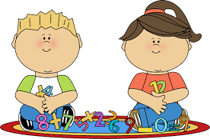
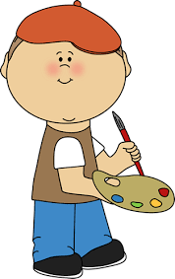
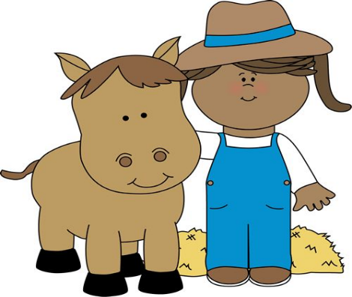
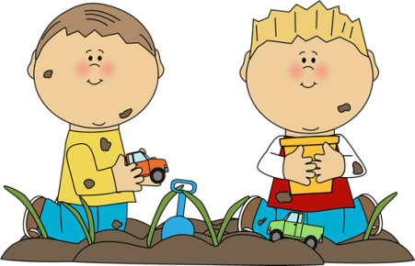
Learning at Home
Reading
Singing
Print – letters & numbers
Mark making
Outings
Playing with friends
Notes:
Here are some fun suggestions:
Reading, sharing books, & library visits help children to make important connections between words and pictures (especially if you point and have two-way discussions). Sharing stories helps to develop language skills. You can take out 30 books at a time from the library!
Singing songs & nursery rhymes with actions helps children to connect words with the actions. It is something you can do every day. Why not try Rhyme Time at your local library?
Print- noticing letters & numbers helps to develop early literacy & numeracy. Make up fun games like looking around for the first letter of their name. Notice print on cereal boxes, numbers on doors and road signs
Mark making- children enjoy using big paint brushes and rollers outside with plain water to ‘paint’ the fence or the wall. This also develops gross motor skills. Chunky chalks for drawing on paving can provide hours of fun and can be easily washed away. Drawing and painting with a variety of brushes and pencils develops fine motor skills that help them to get off to a good start at school
Outings - help children to understand their immediate world & community including basic geography, history and nature
Playing with friends & socialising supports complex social skills, feelings of acceptance and a sense of belonging. It’s also great for letting of steam & burning any excess energy. It’s great to connect with others ☺.
These are all things that you may already be doing, but it’s helpful for you to know why they are so important.
*Evidence from the National Literacy Trust shows that children thrive when they feel listened to; their ideas are taken seriously; and their language & thinking is encouraged. Home is somewhere where we develop our love of learning and exploring.
[Discussion if time permits]:
What other play activities do you do with your child in the home and community?

Slide 10
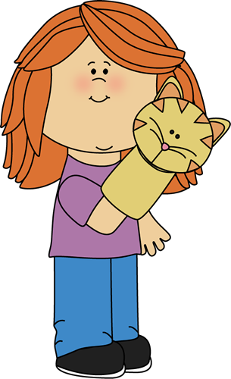
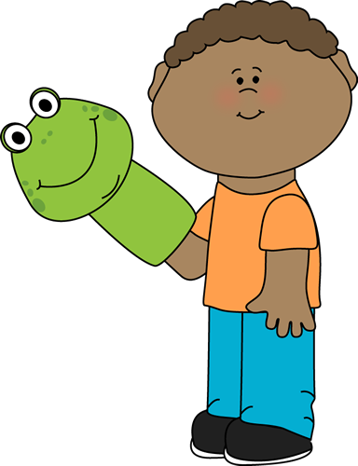
I am able to follow simple instructions and make some simple choices
Notes:
The Kindred Squared Report states that 37% of children are unable to listen and follow simple instructions. Sometimes it’s quicker and easier for adults to do things for children, rather than to instruct a child to carry out a simple task, but it’s a skill that can be developed through play and everyday scenarios. Here are some ideas:
Play ‘Simon Says’
Play ‘Go Games’ (also helps with turn-taking)
Organise a role play shop, with real food and ask your child buy you an apple; when they bring one correct item consistently, you can add additional items and ask for an apple and an orange (also good for memory)
Make a post box out of an old box and ask your child to post various items
Make a ‘listening box’ with various items like rattles, bells, rice and pasta in plastic containers – without your child being able to see it, shake each item in turn, so they can guess what is making the sound (good for listening skills – you need these to be able to remember and carry out instructions)
Cooking – following a recipe
Ask your child to fetch their coat, find a toy, pass a message to somebody
Always use their name to get their attention before giving an instruction
Giving children choices helps them to feel that they have some control and power over their lives. It’s also a functional way for them to learn how to make decisions, express their preferences and to learn the consequences of making poor choices. As children get older, they need to make many decisions every day, so it’s important to start young in order to build self-confidence!
For young children, provide constructive choices, for example ask if they would like milk or water or whether they want to wear red shoes or blue shoes – this also encourages them to use the word which impacts positively on speech development. Two choices is enough to start with.
As children start to develop their decision-making skills, they may make some mistakes, for example choosing a book at the library that you thought they wouldn’t enjoy or buying a cheap toy that breaks quickly – this is a way for your child to learn that their decisions have consequences - just resist the urge to say, “I told you so!”
With practise, children will start to trust their own instincts and become skilled decision makers.

Slide 11

I am able to concentrate for short periods of time
I am able to have a go at new experiences and keep trying
Notes:
By the time children start school, they will be expected to be able to sit still and concentrate for short periods of time. The Kindred Squared Report revealed that 46% of children had not reached this milestone by the time they started school; it emerged as the highest area for concern.
We know that it can be very difficult for young children to sit and that is why early years settings and schools provide a play-based environment with plenty of opportunity for large-scale physical play, as this also enhances concentration.
In a high-tech world, there is an increasing body of research suggesting that excessive screen time can make it challenging for children to pay attention and concentrate on tasks that require sustained focus. For children with ADHD, the constant stimulation of a screen can worsen existing difficulties with focus and attention.
‘For a brain to develop and grow, it needs essential stimuli from the outside world. More importantly, children need time to process those stimuli. While reading storybooks out loud gives children time to process words, images and voices, the constant absorption of on-screen images and messages affects their attention span and focus.’ (Unicef)
There are some simple games and activities that may help to increase focus:
Memory games – place items on a tray and then cover them up
Matching games – with picture cards
Recall what happened in a story book
Jigsaw puzzles
Spot the difference puzzles
Approaching new experiences and working at them until we succeed or solve a problem, requires a growth mindset and sometimes moving outside of our comfort zone. It’s great if you can model this for your child, for example when you find something difficult, speak out loud and show that you will keep trying different ways until you succeed. If you see your child becoming frustrated with a task, support them to do the same. This will build their resilience and problem-solving skills.
Notice the effort and time they put into a task, and the desire to keep trying different ways of achieving something, as well as the end product. Chat about how it felt to overcome any difficulties and what you learnt from the process.

Slide 12
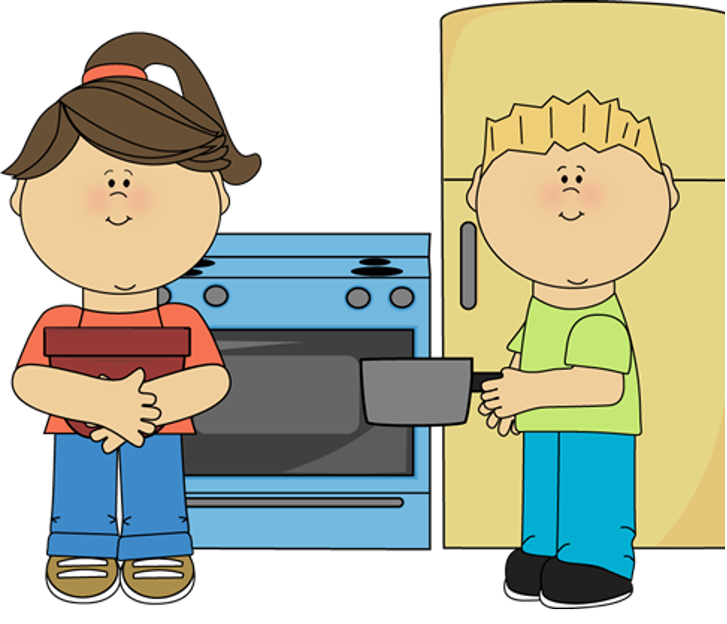
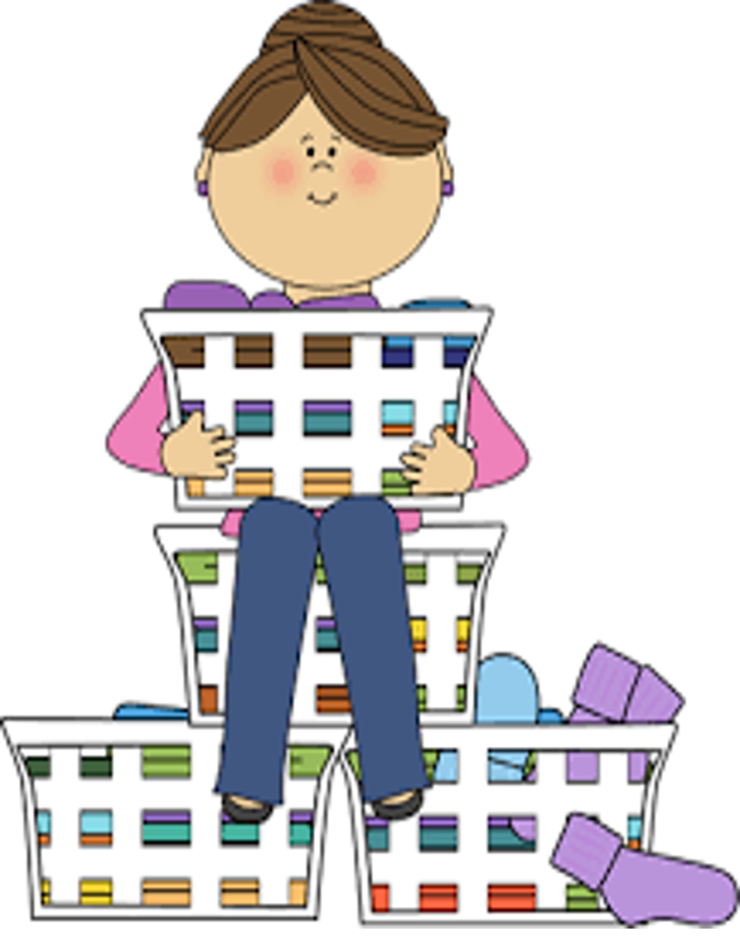
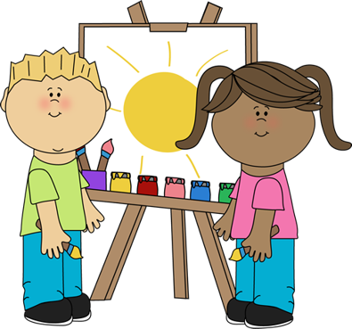
Early Independence at Home
Notes:
Encouraging early independence in daily routines and the home learning environment will help your child’s self-esteem and sense of worth. Children love to mimic adults and will be paying attention to everything you say and do. They see you being independent, and they will want to have a go and mirror you.
Preparing snacks and meals is often seen as an adult activity but there are many benefits in involving your child. Using cooking utensils, for whisking, chopping, stirring, spreading and peeling, all help with manual dexterity. Get your child to put spreads on their sandwiches or crackers and to cut soft foods. Pouring drinks and using different serving utensils will help your child to be independent at school mealtimes.
Sorting the never-ending laundry that comes with parenting is a great opportunity for pairing, matching and folding, so this involves your child in problem-solving. Believe it or not, this helps them to develop their maths skills (think of the language involved in folding things into halves and quarters or whether something is a square or an oblong). This is also helpful for them when they’re handling their own clothing before and after P.E. and hanging up their coats & bags on their pegs.
Children love to play independently and experiment with open-ended materials like gloop, mud, sand and water. There is no particular end product, so this kind of play can be very relaxing but at the same time they will be learning about things like tipping and pouring. These skills are also useful at mealtimes.
Patiently involve your child in clearing up their own spillages and try not to worry about the mess as it is all part of the independent learning process that leads to a love of learning.
It’s important to give children the freedom to create and design their own paintings and drawings. By resisting the urge to step in and take over, you are giving your child independence and the message that you value their ideas & creativity. Again, notice the detail and the amount of effort they put into their creations, e.g. “I noticed you spent a lot of time on your painting! You mixed yellow and blue to make green.”

Slide 13

I use cutlery, drink from a cup and eat by myself
I get dressed by myself and clean my teeth with some help
Notes:
Sometimes you may not have the time to let your child get dressed independently, but the evidence shows that if you allow them independence whenever possible , they feel better about themselves and will be far more willing to co-operate when they have no choice. It’s likely that you will see less distressed and frustrated behaviour too.
By the time your child starts school, they should be able to put on their own coat & shoes, and dress themselves after using the toilet. Although we often have busy lives and time restrictions, allow your child to get dressed independently whenever possible. This requires uninterrupted time to concentrate and keep trying which are two skills that have already been explored in this session. Using dressing-up clothes for role play is also helpful – having clothing in a larger size for dressing up will help to make it easier and less frustrating.
When the time comes for your child to start school, ask about pre-loved uniform availability, and they may be able to provide further support if you require it.
Children should brush their teeth twice a day for two minutes, with the help of an adult until they are at least seven years old. Use family toothpaste containing around 1500 parts per million (PPM) fluoride. Bedtime is most important as saliva slows down and bacteria can multiply. Spit but don’t rinse as the fluoride provides protection. Also avoid sweet or sugary foods and drinks an hour before bedtime and after brushing. Drinking from an open or free flowing cup without a valve is preferable to using bottles, particularly baby bottles with teats (transition to a cup is desirable by the age of twelve months). Nearly a quarter of children start school with tooth decay affecting three to four teeth on average, and tooth extraction is the biggest reason for children aged 6-11 to be anaesthetised. This also affects school attendance.
When starting school, children should be able to use cutlery, feed themselves and drink out of an open cup. The Kindred Squared Report revealed that 29% of children had not reached this milestone. Eat together when possible and encourage your child to use appropriate cutlery at mealtimes. You could also encourage your child to practice peeling bananas & satsumas and taking the tops off yoghurt pots.
Playing with tea-sets and setting up teddy bears’ picnics might be helpful as well as asking your child to help lay the table. As mentioned before, handling a variety of utensils during cooking activities helps children to develop fine motor skills.

Slide 14
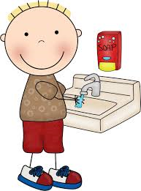
I go to the toilet on my own and wash my hands afterwards
Notes:
It’s estimated that nearly a quarter of children (24%)* are not toilet trained when they start school. Occasional ‘mishaps’ are to be expected but this number represents frequent mishaps. There is lots of advice available on the ERIC website and support is available from your health visiting team or you could text Chat Health on the free messaging service.
We have some top tips for toilet training:
Start to change nappies in the bathroom
Start to use a potty from 6 months to practice the skills needed in preparation for potty training
Potty train from 18 months to 30 months (that’s one-and-a-half to two-and-a-half years old) as this is the ideal timeframe
You do not need to wait for your child to tell you or show you signs they are ready
Remain calm and get your child to help clean any ‘accidents’ (there will probably be many) and try again next time
Avoid pull-ups when out and about, this can confuse them
Avoid squash as this can irritate the bladder and make accidents worse
Some children can be dry at night from when they start potty training and for others it can take up to the age of 5. One in three children suffer with constipation which can affect potty training.
Children with additional needs can be potty trained, it may just take a little longer.
It’s also useful if children are independent with hygiene procedures like blowing their own nose and washing their hands before they start school. Hand washing is one of the best ways to avoid the spread of germs.
Having a visual sequencing chart that guides children through each step of daily routines, such as toileting, nose blowing, and getting dressed can be very useful for keeping children on task, especially if each picture is individual and can be removed
and posted into a homemade post box as soon as it’s completed.
*Kindred Squared

Slide 15
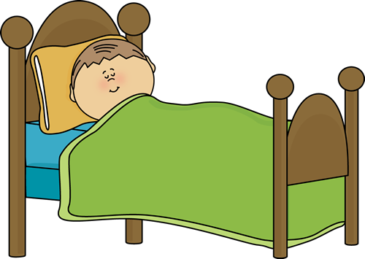
I can relax and I have a regular bedtime
Notes:
Spending some time mindfully relaxing can help children to settle their nervous system. Sometimes they get over stimulated and need to co-regulate with a calm adult. Children need a diverse menu of experiences, including the chance to let their minds wander, because this is often the space where creativity and imagination blossoms.
Instead of screen-time, often the first choice for children, these are some alternative ideas:
Go outside for a listening walk
Do some cloud spotting
Have a pamper session – hand massage, head massage, foot massage
Do some yoga or stretching & breathing exercises (e.g. teddy bear breathing; ‘hot chocolate’ breathing; butterfly hugs)
Calmly and slowly blow bubbles
Make a cosy corner or den with blankets and cushions and dim the lights
Just as we mentioned when talking about co-regulation, dip into a calming sensory box
Sleep is essential for a child’s development. Lack of quality sleep can lead to irritability, anxiety, lack of self-regulation and disruption to memory & learning. 4 to 5- year-olds typically need 10-13 hours of sleep and 6-13-year-olds typically need 9-11 hours of sleep in any 24-hour period
These are bedtime some tips to help your child to sleep well:
Set a consistent bedtime, even at weekends
Maintain a consistent bedtime routine – e.g. a warm bath, putting on nightclothes, calm conversation, sharing a soothing story and a cuddle (might vary for individual children)
Keep electronic devices out of the bedroom and avoid screen use 1-2 hours before bedtime (that includes TV and all electronic devices) as they stimulate the brain, making it harder to wind down for sleep
Avoid scary or violent TV programmes, video games and stories as feeling scared or worried is a common reason that children can’t sleep
Avoid caffeine (found in energy drinks, tea, coffee and chocolate)
Make a ‘sleepy bedroom’ – reduce noise; dim the lights; use calming scents like lavender; ideal temperature is around 18 degrees Celsius; check for anything that may look scary
Avoid chatting about worries close to bedtime – make time to discuss these concerns and how to cope with them during the day
Practice mindful breathing techniques
If your child calls out for you, keep ‘room checks’ short and reassuring – let your child know they are safe and that you are not far away

Slide 16
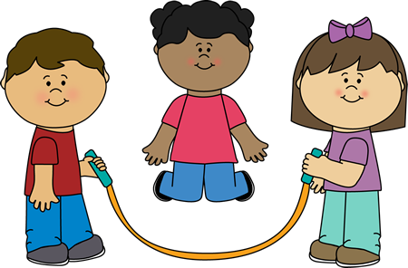
How much daily physical exercise do the under 5s need?
60 minutes (1 hour)
120 minutes (2 hours)
180 minutes (3 hours)
I am physically active
Notes:
The UK’s Chief Medical Officer recommends that children up to the age of 5 years should have a minimum of 180 minutes (3 hrs) physical activity a day to stay fit and well.
There is a strong link between physical activity and emotional well-being.
Long periods of sitting and inactivity can lead us to feel sluggish, tired, irritable and sometimes low in mood. Inactivity (such as screen time) can have a negative effect on mental health, and of course physical health. When children use screens, it stops them from doing other more physical activities. This can impact on their weight and overall well-being.
Children need lots of opportunities to be physically active, and to get their hearts pumping through activities such as running, jumping, climbing, and cycling. This helps the brain to produce endorphins – they help us to feel good and allow the brain to be in the best state for learning.
These recommendations help children to maintain a healthy weight and strong muscles & bones.
Physical exercise also helps to develop gross motor skills because it works the large muscle groups in the body.
A bout of physical exercise can settle the nervous system. Letting off steam can also help children to think more clearly, increase attention span and help with problem solving. This all helps to keep children in the learning zone.
It also helps children to have healthy sleep routines. In other words, physical activity has huge benefits for mental health and well-being.

Slide 17

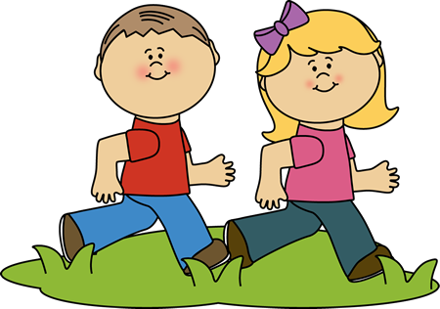
I have a healthy lifestyle
Notes:
Encouraging a healthy lifestyle in the early years will help your child to get off to a flying start in life.
Having good, nutritious food and a balanced diet can really help them to stay healthy and to concentrate on learning. Staying focused is hard with a rumbling tummy! Remember school meals are free at infants’ school. Your child may eat better at school when they are seeing their peers eat.
You may opt to send a packed lunch for your child when they start at their early years setting or school. Please remember to make sure they can open their lunchbox. Avoid sugary snacks – we’ll provide ideas for healthy lunchboxes via the padlet. The setting or school will let you know what should be avoided due to allergies. For example, this could be no nuts allowed.
Get your child involved with shopping and looking at what has too much sugar and salt. A fun way of doing this is to download the free sugar swaps app. This will show how much sugar or salt is in the food and what to swap it with.
We have a ‘Family Food and Fun’ session where we explore the Eatwell Plate and portion sizes. In the session, we also look at ideas for fun activities that you can enjoy together as a family. The link for booking will be sent to you.
To protect your child from certain diseases, you should get an invitation for a second dose of MMR (measles, mumps, rubella) at 3 years and four months. They will also be offered a four-in-one booster to protect them against diptheria, tetanus, whooping cough and polio at the same time.

Slide 18
What is School Readiness?
Child
Curious
Excited
Sociable
Confident
Enthusiastic
Independent
Family
Play
Talk
Relax
Choices
Routines
Resources
School
Trust
Transition
Experiences
Environment
Relationships
Communication
The three Rs – Ready Child, Ready Family, Ready School – Unicef
Notes:
Depending on your child’s date of birth, some will be going to school just after they’re four years old and others will be closer to five. It can feel daunting for parents, especially those with summer-born children, who will be going to school at a younger age.
The Kindred Squared Report states that 2.5 hours of teacher time is lost each day because children are not ready for starting school.
43% of parents hadn’t heard of the idea of school readiness and the connection to developmental milestones before their child was four years old.
43% of parents also said that they found out about school readiness too late and wished they had known before about the full range of skills that their child should have.
This is why this session is being aimed being aimed at parents of children from two years old, as it will give you plenty of time to think about and support the skills & developmental milestones required for a confident start to school. Also, when children are making progress with their growing independence, communication, and physical skills, there is usually a positive impact on their emotional development and behaviour. This is especially true when they also have healthy and consistent routines, including management of screen-time.
What you see on the slide is known as the ‘three pillars of school readiness’. This is the UNICEF model, describing the ready child, ready family and ready school that has been adopted by Hampshire County Council.
The words you see within the three pillars help us to understand the foundations for the most important skills, attitudes, activities and behaviours that enable children to be ready for school when the time comes. Think about three words to describe your child and check to see whether they appear in the first column ☺

Slide 19

Individual Needs
Individual needs
Education, Health & Care Plan
Reasonable adjustment
Summer-born children
Notes:
The Early Years Foundation Stage guidance recognises the ‘unique child’. It’s important to make the school aware of any particular needs that your child has.
Maybe you’re concerned that they have undiagnosed special educational needs and/or disabilities – if so, make sure that the early years setting or school is aware of your concerns, because early intervention can be the best intervention (while there is a relatively high level of plasticity in your child’s brain).
Involving your child’s key person from their early years setting can be very beneficial when your child transitions to school as they will be able to give their opinions and and advise on how they have met your child’s needs.
The Equality Act (2010) states that ‘reasonable adjustments’ must be made to ensure that your child can access mainstream schooling where possible and all of the opportunities on offer.
The early year setting or school may wish to put an Education, Health & Care Plan in place for your child. All of the information that you can contribute is extremely valuable in this process.
Specific diets to meet religious and medical needs can be accommodated (although for medical or allergy requirements you may be asked for confirmation from your G.P.). Make sure you speak to the school about this. Also ensure that you talk to the school about any medication such as inhalers and epi-pens so that appropriate arrangements can be put in place.
Summer-born children, who start school soon after turning four, may need extra sensitivity and flexibility to help them settle in. If there’s anything you think might help your child to feel settled, suggest it to their class teacher. Remember, you know your own child best.
The more information you can provide about your child, the more the school can prepare and be ready for their arrival.

Slide 20




Applying for school when the time comes
October
Start looking at schools
November to January
Complete application
April
Allocated school communicated with you
Summer Term
Transition Process led by the school
Notes:
Schools in Hampshire open their doors to prospective parents as early as October in the year before a child will start school. It is recommended that you visit a school to support your final choices for application. Visiting in person gives you an opportunity to view the school’s offer including the learning environment, facilities, policies & aims plus the chance to ask questions that are important to you as an individual family.
The school applications portal for the year ahead opens in November and closes in January. Your allocated school will be communicated to you in April of the year your child will start school. Schools will then be in direct contact to inform you of important dates for settling-in activities. Some schools may also offer a home visit in their transition process.
Everything you need to know about applying for a school place is detailed on the Hampshire County Council website. This includes a list of Hampshire schools, admission guidance, arrangements & regulation, information for families of children with SEND, travelling arrangements and how to go about appeals. There is a handy FAQ section too.
The link to this website page will be provided in the padlet sent to you following this session.
Here are some key points to consider:
The list of schools on the website includes a catchment school finder option
If you apply to your catchment school, it is likely that you will have a high priority for a place but that cannot be guaranteed
It is strongly recommended that you name more than one school on your application to maximise your chances of being offered a place at a preferred school
Make sure you get your application in within the portal opening times (November to January). A late submission is only considered after all other places have been allocated.

Slide 21
What to expect at school from the school nursing service
Advice and guidance around emotional health and wellbeing, healthy lifestyles and many elements of your child's health and wellbeing
All 5-year-olds in England are offered a vision screening and growth measurement review
Sign-posting to other professional services that may be able to offer more in-depth support
Notes:
Your child will have contact with the school nurse from time to time.
All 5-year-olds in England are offered a vision screening and growth measurement review to identify any problems with their eyesight and to check they are growing as they should be. The measurements are taken by trained healthcare professionals, within the public health school nursing team – a letter will follow from your school with more information.
Weight and height are rechecked at the end of year six. School nurses are also involved in the immunisation programme at various stages through school including the annual flu vaccine.
The school nursing service offers advice and guidance around emotional health and wellbeing, healthy lifestyles and many elements of your child's health and wellbeing discussed in this session, also sign-posting to other professional services that may be able to offer more in-depth support.

Slide 22
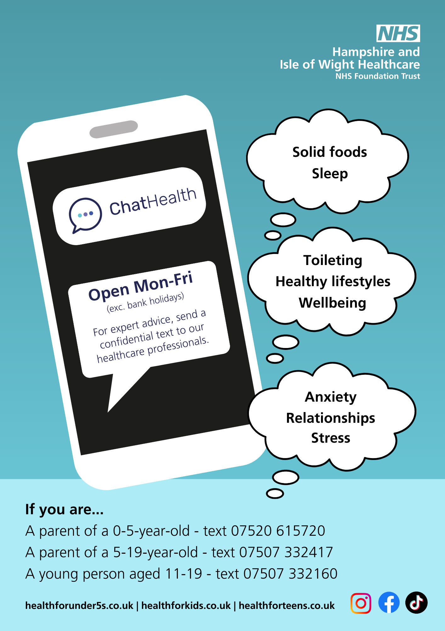
If you need further support…
Notes:
From time to time, you may have worries and concerns about your child’s health and development. It’s reassuring to know that your health visitor or a school nurse is there to help.
ChatHealth is a text message advice service for parents and carers of children aged 0-19 across Hampshire.
The 0-5 ChatHealth service is run by the health visiting teams (pre-school children).
The 5-19 ChatHealth service is run by the school nursing teams.
We’ll send you web links so that you can find out the full details of the immunisation programme and 0-19 ChatHealth services with our post-workshop email so that you have the numbers handy.

Slide 23




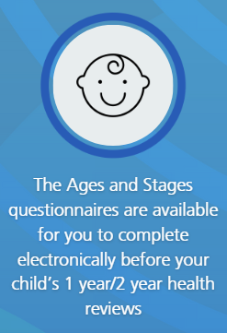
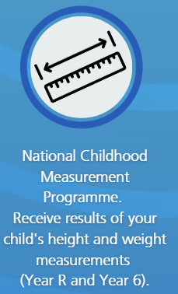

Parent Information Portal (PIP) a web-based platform to give you digital access to your child's medical records in one convenient location.
To sign up email pip@southernhealth.nhs.uk
Or
Contact your local Health Visiting or School Nursing team
You will be asked for some details as part of the verification process
Notes:
We’d like to bring your attention to a new part of the service the Parent Information Portal (PIP).

